Slide 1

Fundamentals of Programming (C#)
Course Introduction
SoftUni Team
Technical Trainers
Software University
https://softuni.bg/

Slide 2
Table of Contents
Course Objectives
Training and Team
Course Organization
Course Infrastructure
Evaluation Criteria

Slide 3
Have a Question?
sli.do
#Fund-Programming

Slide 4

Course Objectives

Slide 5
Course Objectives
Working with linear data structures
Arrays and Lists
Defining simple classes
Processing and manipulating strings
Regular expressions
Building а simple web project

Slide 6
Practical Programming Exam
Mid Exam
3 practical problems for 4 hours
Conditional Statements and Loops
Arrays
Lists
Final Exam
3 practical problems for 4 hours
Associative Arrays
Strings and Text Processing
Regular Expressions

Slide 7
Theoretical Exam
You will have 30 minutes once you enter
Multiple choice with 1 or more correct answers
English
Automated quiz system
Available online the day before the practical exam
You can submit your answers just one time

Slide 8

The Team

Slide 9
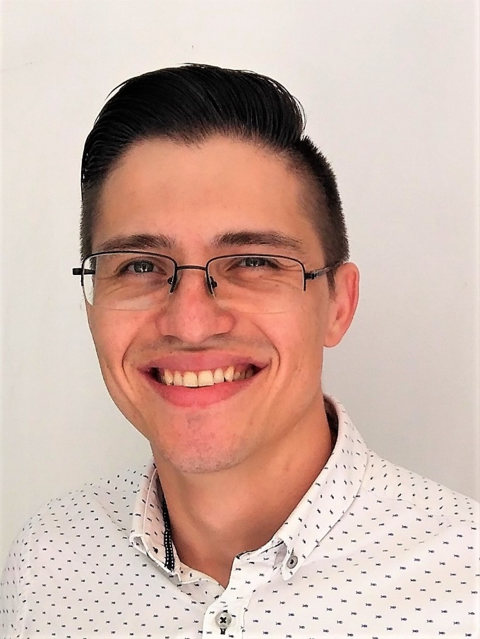
Преподаватели
Аlen Paunov
Educational Director of Software University.
He is part of the Softuni’s team for more than 2 years and his leadership and management skills are focused at developing the other trainers and giving the best skillset to the students of SoftUni.
Alen’s previous experience was in the legal sphere, but he considered a life-changing option to join, study and work at Softuni and help other people grow and find their way into the world.

Slide 10

Course Organization

Slide 11

Homework Assignments & Exercises
Your homework:
Lesson days → slides + live demos + exercises
How to submit your homework?
Submitted in the judge system
Do your homework when it's due
Assignments pile up quickly

Slide 12


Scoring System for the Course
Theoretical Exam 10%
Practical Exam (Final + Mid) 90%
Bonus Homework 10 %
Evaluation

Slide 13



Course Web Site, Forum and FB Group
Official web site:
Official discussion forum:
Official Facebook group:
softuni.bg/trainings/2438/csharp-fundamentals
softuni.bg/forum/categories/44
https://www.facebook.com/groups/FundamentalsofProgrammingwithCSharpJanuary2020

Slide 14
https://softuni.bg/courses/technology-fundamentals

Slide 15












SoftUni Diamond Partners

Slide 16




SoftUni Organizational Partners

Slide 17




Trainings @ Software University (SoftUni)
Software University – High-Quality Education and Employment Opportunities
softuni.bg
Software University Foundation
http://softuni.foundation/
Software University @ Facebook
facebook.com/SoftwareUniversity
Software University Forums
forum.softuni.bg

Slide 18

License
This course (slides, examples, demos, videos, homework, etc.) is licensed under the "Creative Commons Attribution-NonCommercial-ShareAlike 4.0 International" license

